Slide 1
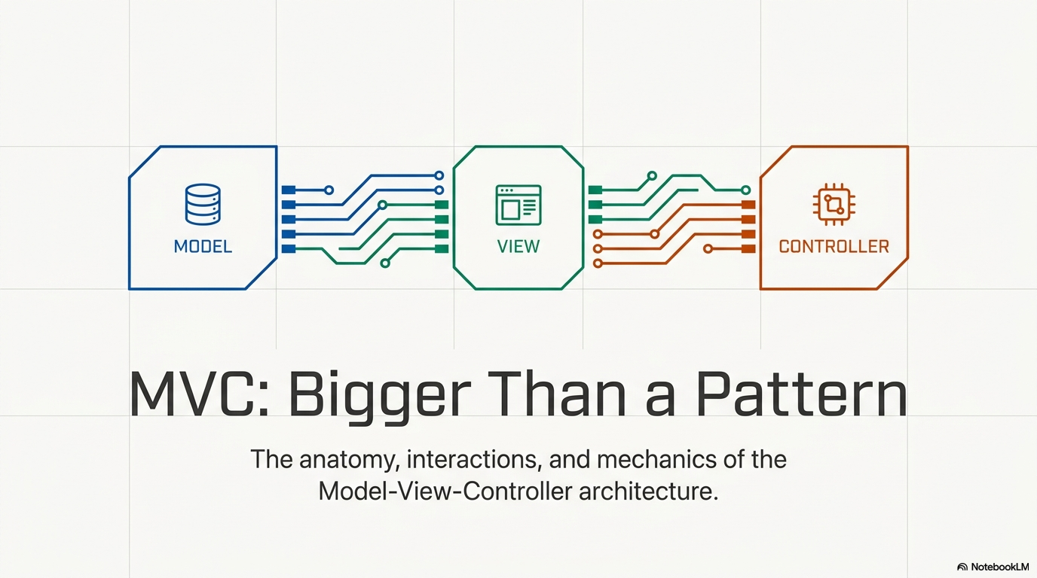

Slide 2
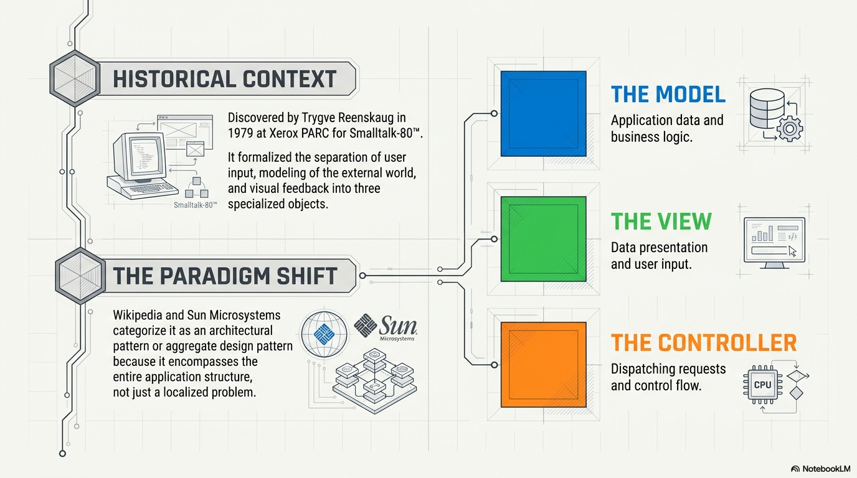

Slide 3
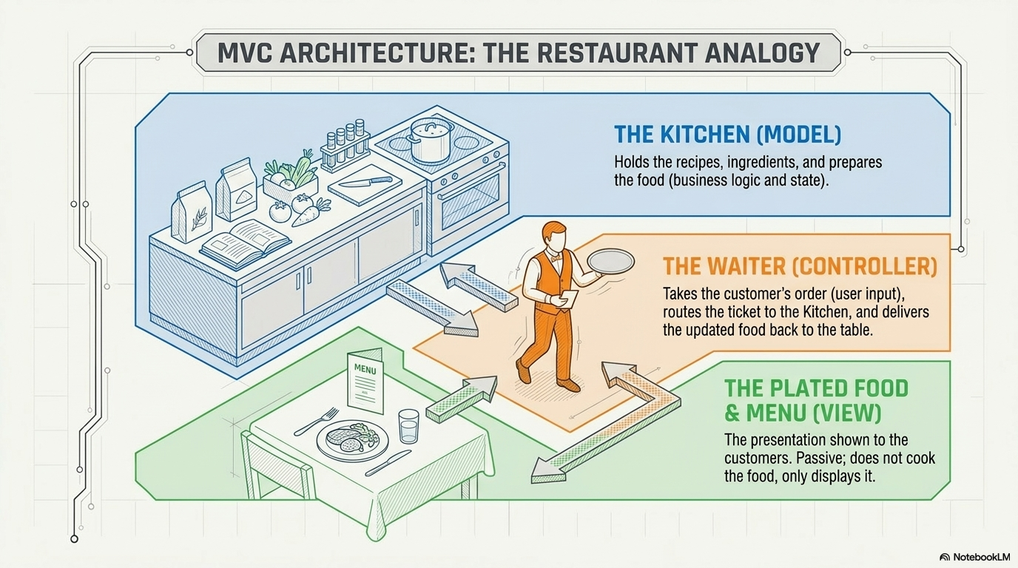

Slide 4
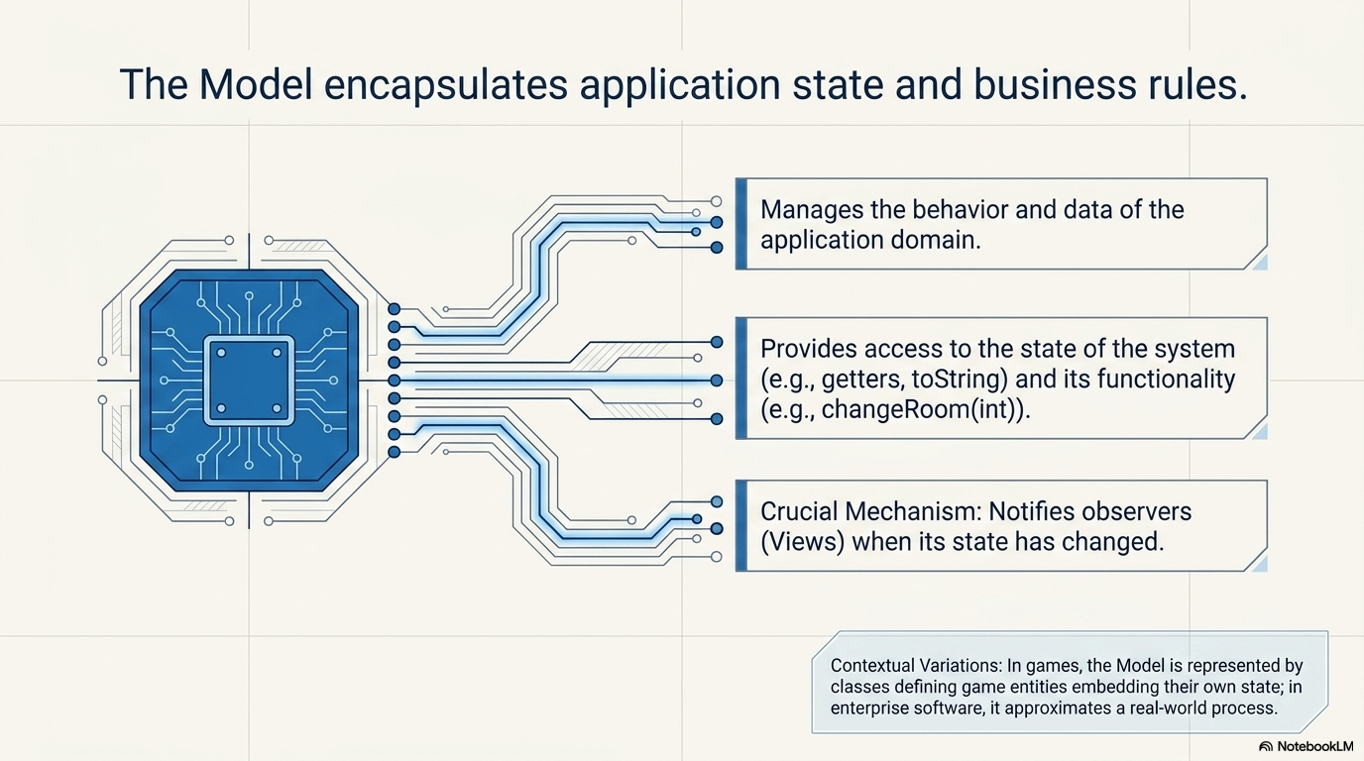

Slide 5
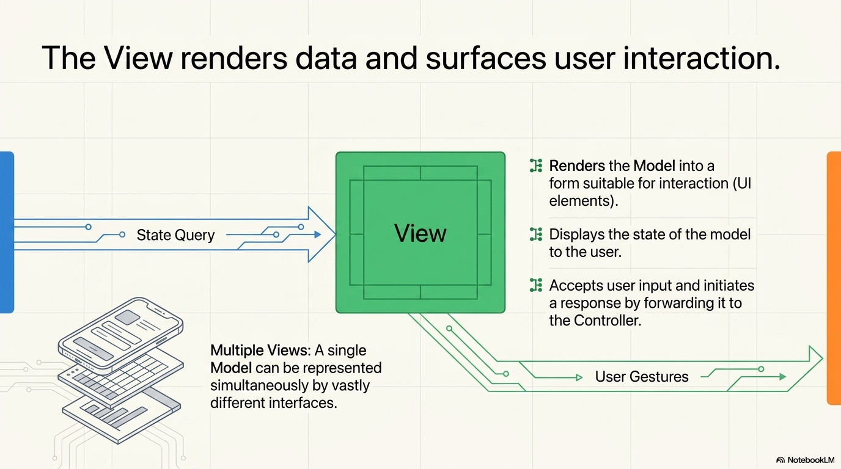

Slide 6
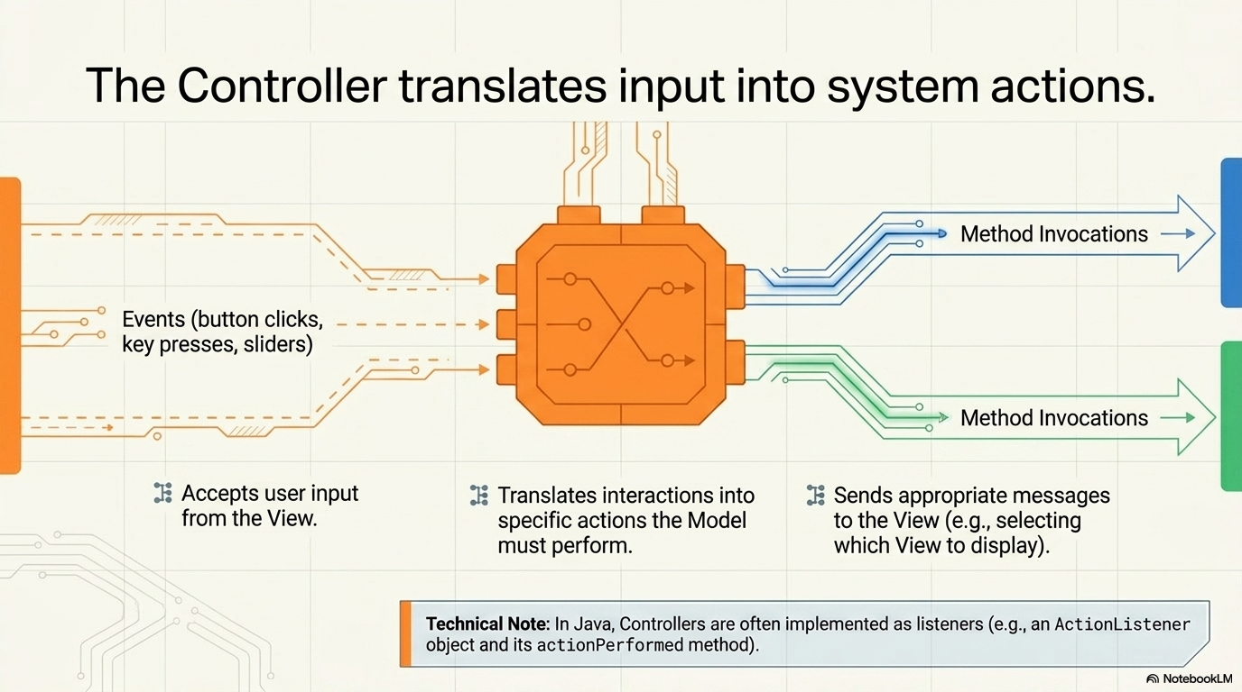

Slide 7
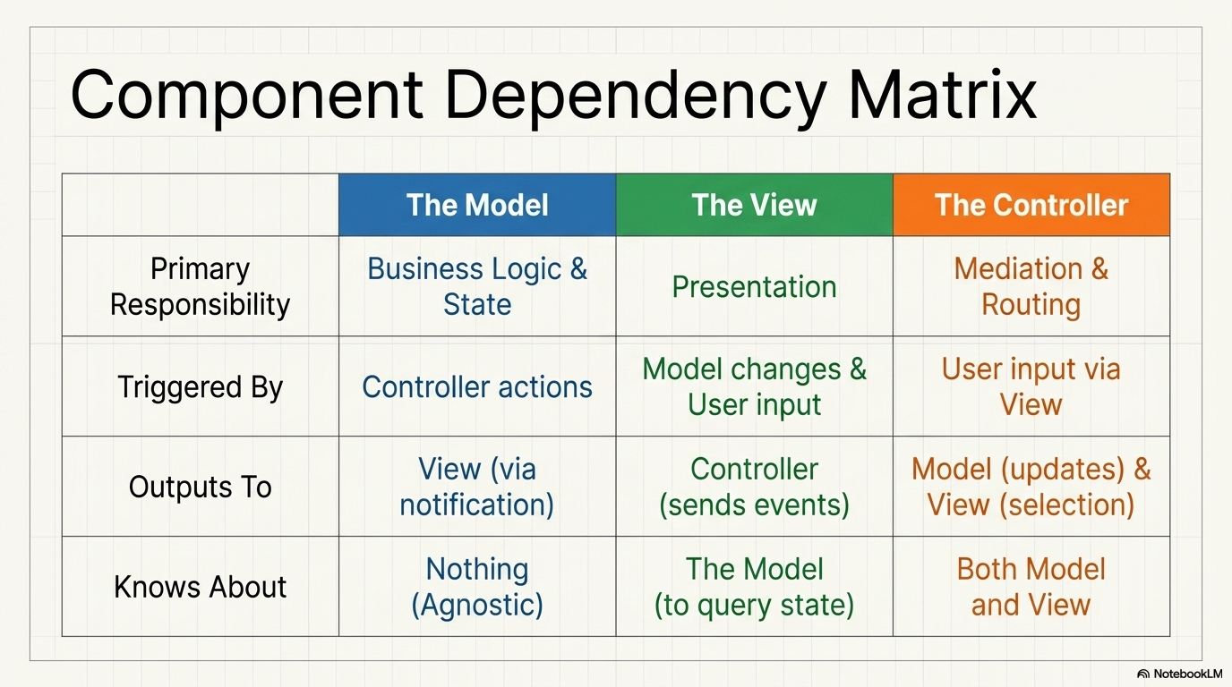

Slide 8
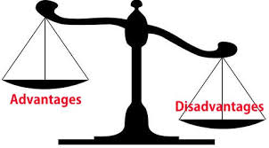
Advantages
MVC provides several benefits that improve application design and development.
Clear separation of concerns improves maintainability.
Allows parallel development of UI and business logic.
Makes testing easier, especially unit testing.
Supports scalability and code reusability.
Disadvantages
Despite its benefits, MVC has some limitations.
Increased complexity for small or simple applications.
Requires more initial design and planning.
Can be harder for beginners to understand and implement.

Slide 9
Java Code Example: Student Management System
public class Student { private String rollNo; private String name; // Getters and Setters public String getRollNo() { return rollNo; } public void setRollNo(String rollNo) { this.rollNo = rollNo; } public String getName() { return name; } public void setName(String name) { this.name = name; } }
1. The Model (Student.java)

Slide 10
Java Code Example: Student Management System
public class StudentView { public void printStudentDetails(String studentName, String studentRollNo) { System.out.println("Student: "); System.out.println("Name: " + studentName); System.out.println("Roll No: " + studentRollNo); System.out.println("-------------------"); } }
2. The View (StudentView.java)

Slide 11
Java Code Example: Student Management System
public class StudentController { private Student model; private StudentView view; public StudentController(Student model, StudentView view) { this.model = model; this.view = view; } // Controller methods to update the Model public void setStudentName(String name) { model.setName(name); }
public String getStudentName() { return model.getName(); } public void setStudentRollNo(String rollNo) { model.setRollNo(rollNo); } public String getStudentRollNo() { return model.getRollNo(); } // Controller method to update the View public void updateView() { view.printStudentDetails(model.getName(), model.getRollNo()); } }
3. The Controller (StudentController.java)

Slide 12
Java Code Example: Student Management System
public class MVCPatternDemo { public static void main(String[] args) { // 1. Fetch student record based on his roll no from the database Student model = retrieveStudentFromDatabase(); // 2. Create a view : to write student details on console StudentView view = new StudentView(); // 3. Create a controller StudentController controller = new StudentController(model, view); // 4. Display the initial state controller.updateView(); // 5. Update the model data (simulating user input) controller.setStudentName("John Doe"); // 6. Display the updated state controller.updateView(); } // A mock database fetch method private static Student retrieveStudentFromDatabase() { Student student = new Student(); student.setName("Robert"); student.setRollNo("10"); return student; } }
4. The Main Application (MVCPatternDemo.java)
Student:
Name: Robert
Roll No: 10
-------------------
Student:
Name: John Doe
Roll No: 10
-------------------

Slide 13
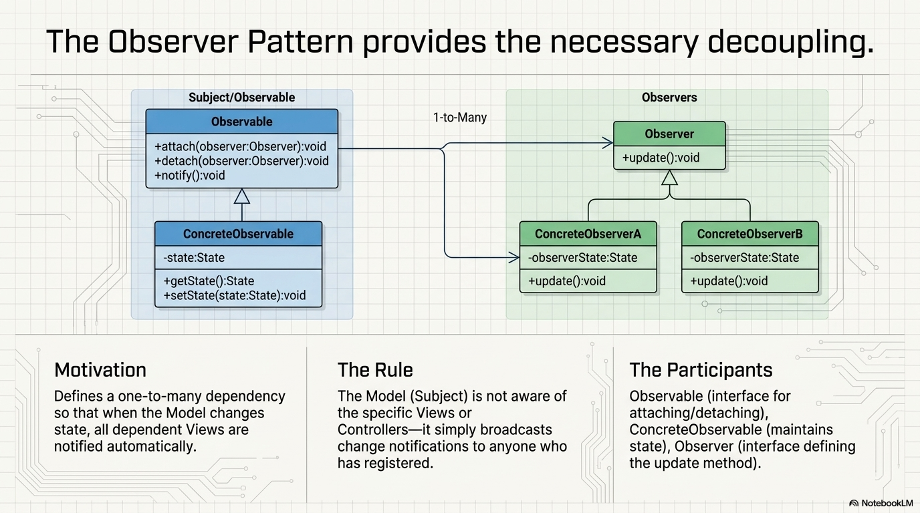

Slide 14
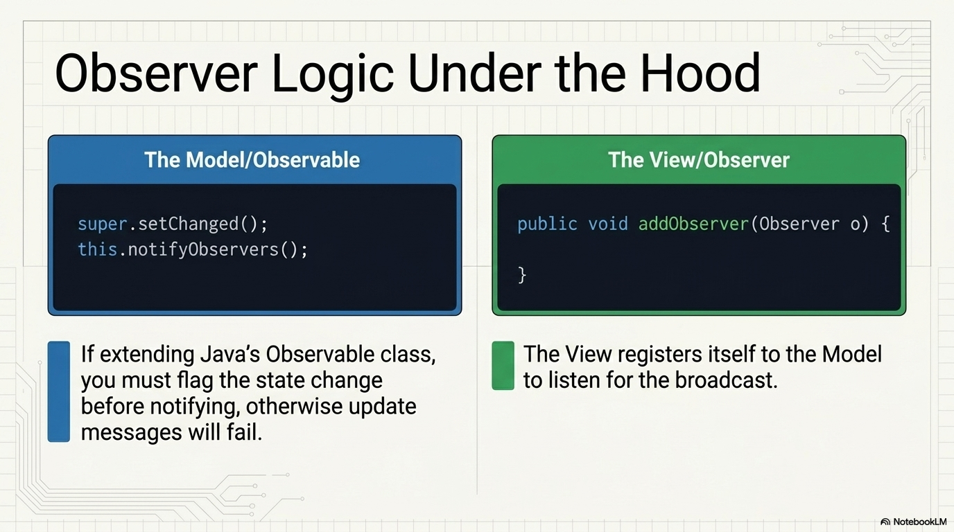

Slide 15
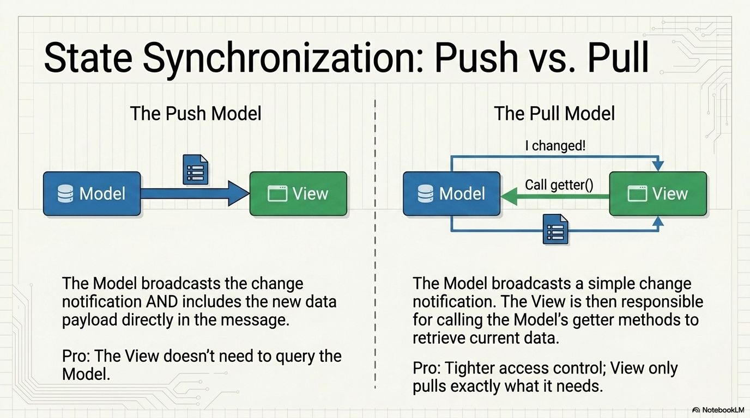

Slide 16
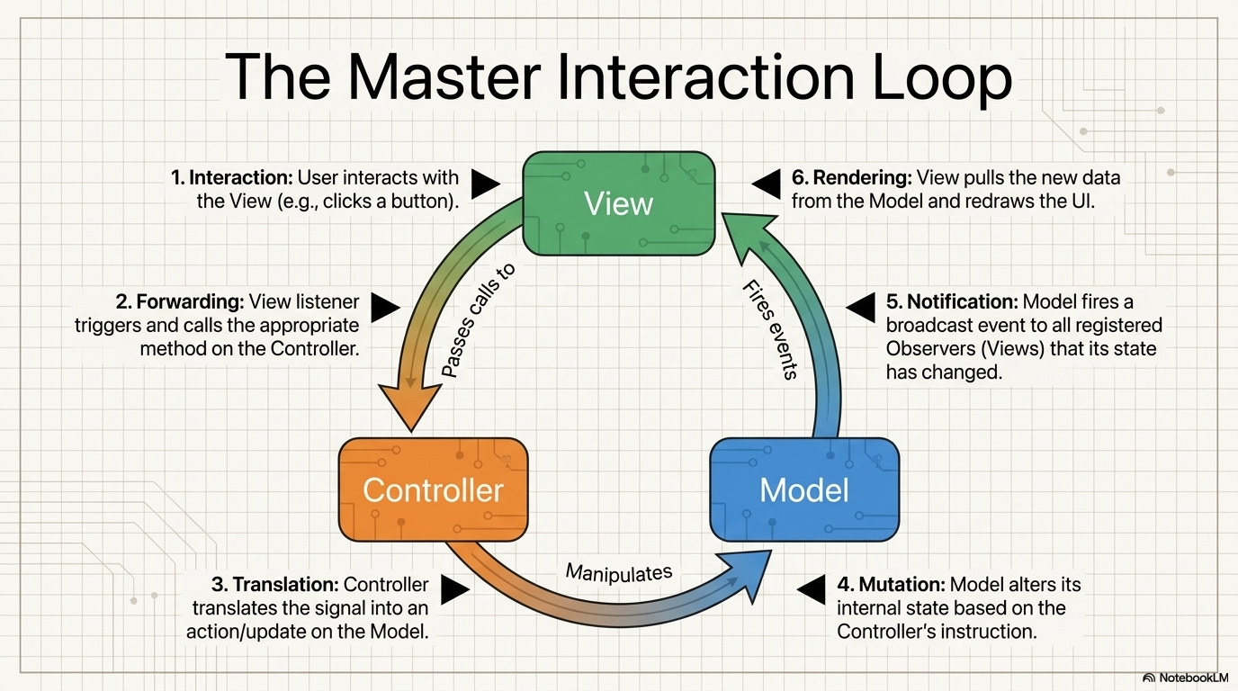

Slide 17
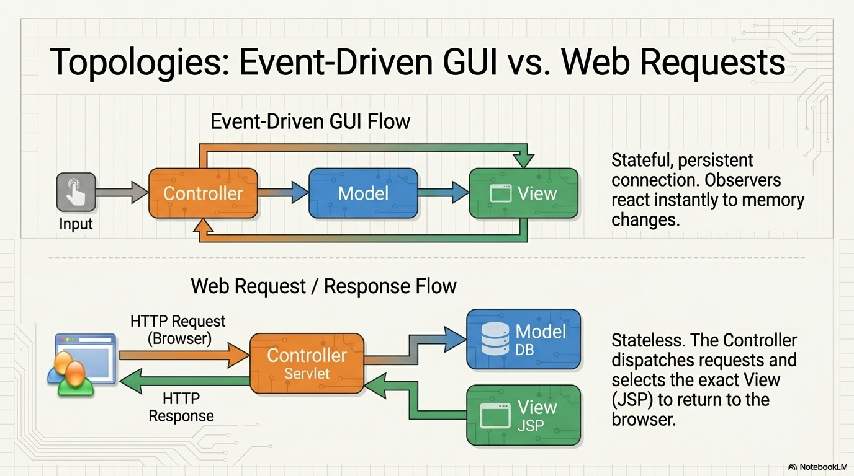

Slide 18
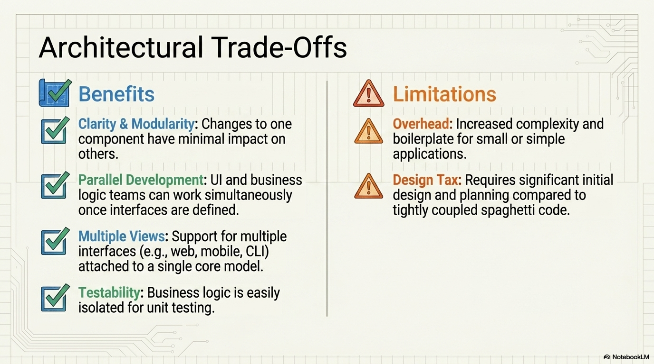

Slide 19
